Slide 1
LEARNING

Slide 2
What is learning
How we learn
Which is your learning style?

Slide 3
Definition of learning
Learning is a relatively permanent change in behavior brought about by experience.
Distinguish between learning and maturation.
Distinguish between short term changes in performance and actual learning.

Slide 4
According To Behavioral School, All Individual Differences In Behavior Were Due To Different Experiences Of Learning. Types / methods of learning
Learning by conditioning
classical conditioning
operant conditioning
Learning by observation

Slide 5
Conditioning
A learning by association is called conditioning, and there is two types of conditioning.
1-classical conditioning
2- operant conditioning

Slide 6
Classical conditioning
Classical conditioning is a type of learning in which a neutral stimulus (bell) comes to bring about a response after it is paired with a stimulus (food) that naturally brings about that response.
It involves learning a new behavior by association

Slide 7
Ivan Pavlov
Classical conditioning was discovered by Ivan Pavlov, a Russian physiologist,
In 1904 he won the noble prize for his contribution to the field of psysiology
Yet Pavlov is remembered for his experiments on basic learning processes that he began quite accidentally.

Slide 8
Demonstration of classical conditioning

Slide 9
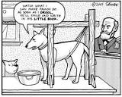

Slide 10
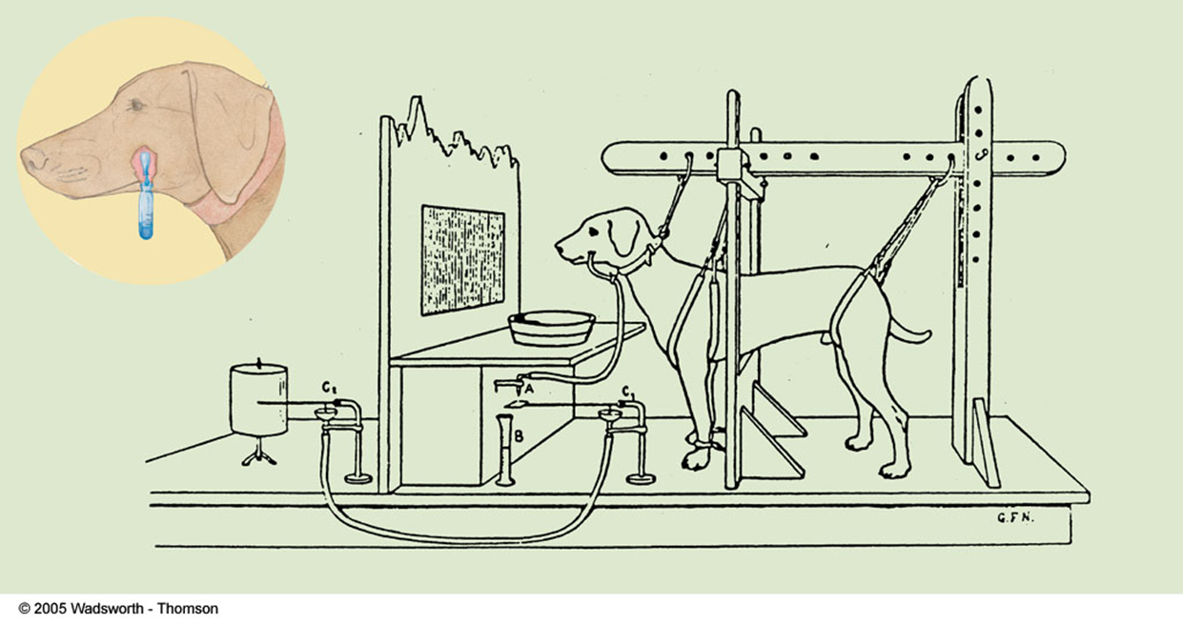

Slide 11
Neutral stimulus
A stimulus that before conditioning, does not naturally bring about the response.
It has no effect on the behavior
The NS could be a person, object, place etc.
The neutral stimulus does not produce a response until it is paired with the unconditioned stimulus.
Bell (NS) + Food (UCS)

Slide 12
UNCONDITIONED STIMULUS
UNCONDITIONED RESPONSE
A stimulus that naturally and automatically triggers a
response without having been learned.
Meat
A response that occurs naturally and needs no learning.
Salivation

Slide 13
Conditioned stimulus
Conditioned response
A response that is being learned by association
salivation at the ringing of a
bell.
The conditioned stimulus is previously neutral stimulus that, after being paired or associated with the unconditioned stimulus, trigger a conditioned response.
Bell

Slide 14
Operant conditioning
UCS UCR CS CR
(Food) ( Salivation) (Sound of bell) (salivation)

Slide 15
before conditioning
Ringing of the bell before foods
UCS
(Food) UCR (salivation)

Slide 16
After conditioning
salivations starts only with the sound of a bell.
CS CR -----------(Salivation)
(Sound of the bell)

Slide 17
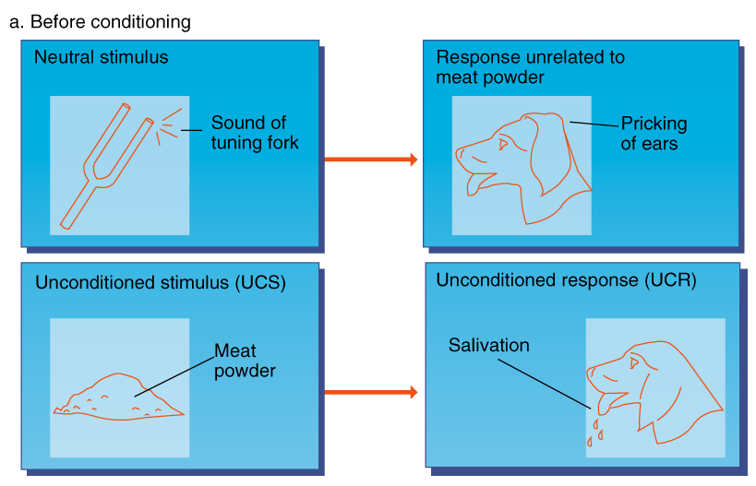
Before Conditioning
Sound of the fork (bell)
No response, (no salivation)

Slide 18
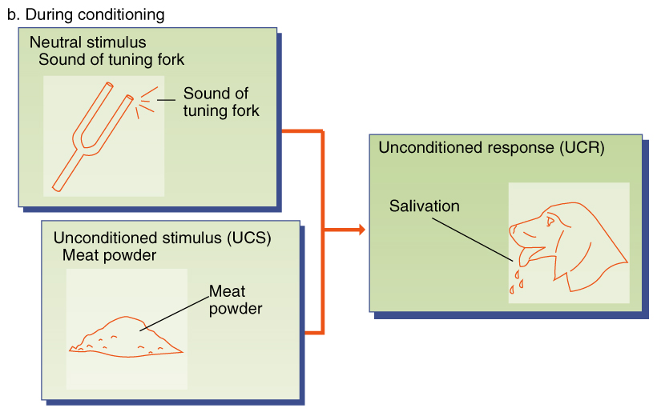
During Conditioning

Slide 19
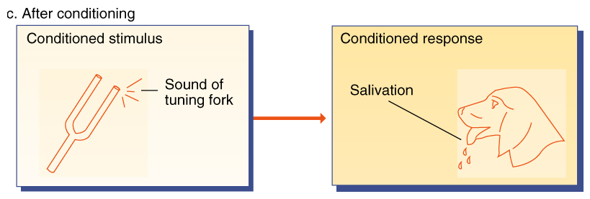
After Conditioning

Slide 20
Principles of classical conditioning
Pavlov have described number of different phenomenon associated with classical conditioning:
1- Acquisition
2-Stimulus Generalization
3-Stimulus Discrimination
4-Extinction
5-Spontaneous Recovery

Slide 21
Acquisition
Acquisition is the initial or first stage of learning when a response is first established and gradually strengthened.
Acquisition occur when a NS and UCS are paired, gradually resulting in a CR.
For example:
A dog to salivate in response to the sound of a bell. You repeatedly pair the presentation of food with the sound of the bell. You can say the response has been acquired (learned) as soon as the dog begins to salivate in response to the bell tone.

Slide 22
Stimulus generalization
Despite difference in color or shape, to us Rose is a Rose.
Stimulus generalization is a process in which , after a stimulus has been conditioned to produce a particular response, stimuli that are similar to the original stimulus produces the same response.
Generalization occurs when an organism responds to new stimuli that is similar to the original stimulus.
The greater the similarity between the two stimuli, the greater the stimulus generalization.
Little Albert who was conditioned to be fearful of White Rats, also grew fear for other similar white furry things as well.

Slide 23
Stimulus Discrimination
Discrimination is the ability of an organism to differentiate between stimulus
The process that occurs if two stimuli are sufficiently different from one another, that one evokes a conditioned (learned) response but the other does not.
for example : our ability to discriminate a growling dog and the dog with wagging tail ----- you would avoid the growling dog and petting the friendly one.

Slide 24
Extinction
Extinction is process by which a previously conditioned (learned) behavior or response decreases in frequency and eventually stops.
If the researcher trained the dog to salivate at the ringing bell, we could produce ‘extinction’ by repeatedly ringing the bell but not providing the meat.
Initially the amount of salivation would probably decline and then the dog would eventually stop responding(salivating) to the sound of the bell.

Slide 25
Extinction
Example:
In Pavlov's classic Experiment, a dog was conditioned(learned) to salivate to the sound of a bell. When the bell rang repeatedly without the presentation of food, the salivation response eventually started to disappear.
A previously Learned behavior is unlearned

Slide 26
Spontaneous recovery
Spontaneous Recovery is the reappearance of a previously extinguished conditioned response after time has elapsed without exposure to the conditioned stimulus
For example, in Ivan Pavlov's experiment, dogs were conditioned to salivate to the sound of a tone. Pavlov also noted that no longer pairing the tone with the presentation of food led to extinction of the salivation response. However, after a two hour rest period, the salivation response suddenly reappeared when the tone was presented.

Slide 27
Operant Conditioning
Very good…………..
Fantastic…………….
Thank you……..
I’m impressed……..
You look great……..
Super……………….
Excellent………….
I love you…………….

Slide 28
Few of us mind being the recipient of any of these comments. But what is especially noteworthy about them is that each of these simple statements can be used, through a process known as operant conditioning. To bring about powerful change in behavior and to teach the most complex task.

Slide 29
Operant conditioning
operant conditioning is learning in which a
voluntary response is strengthened or weakened,
depending on its favorable or unfavorable
consequences.

Slide 30
Cont……..
A type of learning in which behavior is
strengthened if followed by reinforcement or diminished if followed by punishment.

Slide 31
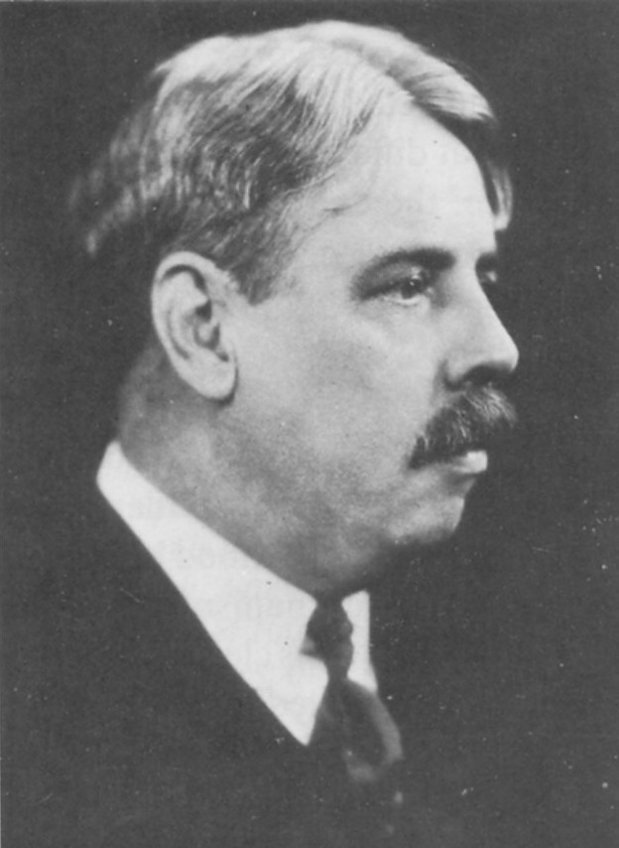
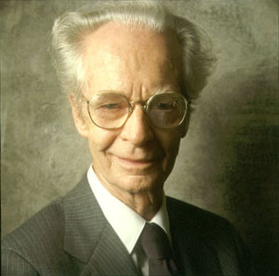
B.F. Skinner Edward Thorndike

Slide 32
Thorndike’s Law of Effect
Responses that lead to satisfying consequences are more likely to be repeated.
If you placed a hungry cat in a cage and then put a small piece of food outside the
cage, just beyond the cat’s reach, chances are that the cat would eagerly search for a way out of the cage. The cat might first claw at the sides or push against an opening.
As the cat moved around the cage, the cat would happen to step on the paddle, the door would open, and the cat would eat the food.
What would happen if you then returned the cat to the box? The next time, it
would probably take a little less time for the cat to step on the paddle and escape.

Slide 33
After a few trials, the cat would deliberately step on the paddle as soon as it was placed in the cage. According to Edward L. Thorndike(1932), who studied this situation extensively, the cat would have learned that pressing the paddle was associated with the desirable consequence of getting food.
Law of effect operates Automatically.
Over time & through experience the organism would make a direct connection between the stimulus and responses without any awareness that the connection exists.

Slide 34
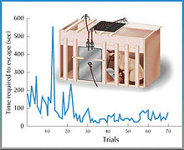

Slide 35
Skinner Box
B.F Skinner (1904-1990)
Skinner Box: a chamber with a highly controlled environment that was used to study operant conditioning processes with laboratory animals.
Animals in skinner box learn to obtain food by operating on their environment within the box.

Slide 36
Skinner box
Suppose you want to teach a hungry rat to press a lever that is in its box. At first the rat will wander around the box, exploring the environment in a relatively random fashion. At some point, however, it will probably press the lever by chance, and when it does, it will receive a food pack. The first time this happens, the rat will not learn the connection between pressing a lever and receiving food and will continue to explore the box. Sooner or later the rat will press the lever again and receive a pack, and in time the frequency of the pressing response will increase. Eventually, the rat will press the lever continually until it satisfies its hunger, thereby demonstrating that it has learned that the receipt of food is contingent on pressing the lever.

Slide 37
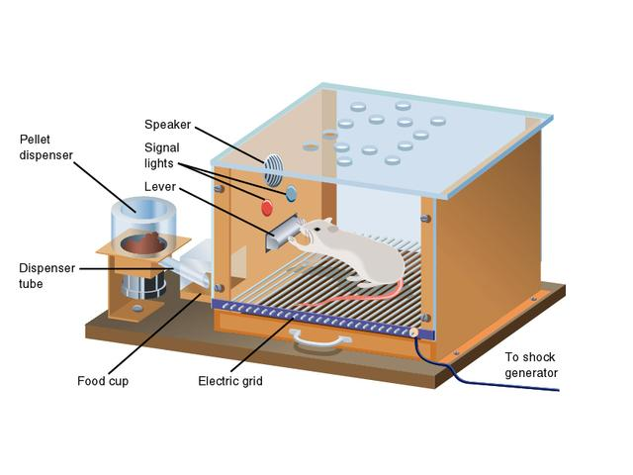

Slide 38
Reinforcement: The Central Concept of Operant Conditioning
Increase the behavior
The process by which a stimulus increases the probability that a preceding behavior will be repeated.
REINFORCER: increases the probability that previous behavior will occur again. (FOOD)

Slide 39
Reinforcement:
Positive (adding)
Negative (removing)
Strengthens a response by
presenting a stimulus after a
response.
Strengthens a response by
reducing or removing a
Unpleasant stimulus.

Slide 40
examples
positive ;
negative
Giving a child a compliment or candy for a job well done.
Watching your favorite TV show after doing all your homework.
Getting paid for a completed task.
The removal of a negative
stimulus following a
response:
Rubbing itchy eyes (reinforces rubbing behavior by removing itch)
Studying when you worry about a test (reinforces study behavior by reducing worry)

Slide 41
punishment
Decrease the behavior
A stimulus that decreases the probability that a previous behavior
will occur again.

Slide 42
punishment
Positive (adding)
Negative (removing)
. Positive punishment weakens a response through the application of an unpleasant stimulus.
Negative punishment
consists of the removal of
something pleasant.

Slide 43
EXAMPLES
POSITIVE
NEGATIVE
Spanking a child
Spending time in jail after committing a crime
Time out : the child is grounded not to watch TV programs because of his poor grades
A boy rides his bike after dark---------------- bike is removed for one week outcome: the boy is less likely to ride his bike after dark.

Slide 44
Classical v. Operant
Classical
Operant
focus on involuntary behavior .
Classical Conditioning is automatic & natural. Dogs automatically salivate over meat, then bell- No thinking involved.
Focus on voluntary behavior.
In Operant Conditioning , organisms influence their environment with to produce /get desirable results.
Behavior is increased or decreased by its consequences.
Reinforcement : increases behavior
Punishment: decreases behavior

Slide 45
Difference b/w classical and operant condition
One of the simplest ways to remember the differences between classical and operant conditioning is to focus on whether the behavior is involuntary or voluntary. Classical conditioning involves making an association between an involuntary response and a stimulus, while operant conditioning is about making an association between a voluntary behavior and a consequence.

Slide 46
Today, both classical and operant conditioning are utilized for a variety of purposes by teachers, parents, psychologists, animal trainers and many others. In animal training, a trainer might utilize classical conditioning by repeatedly pairing the sound of a clicker with food. Eventually, the sound of the clicker alone will begin to produce the same response that the taste of food would.

Slide 47
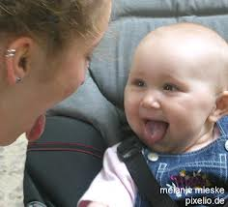
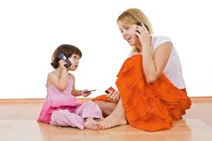
Observational Learning
Social learning theory

Slide 48
Observational Learning
Leaning by observing others is also called SOCIAL LEARNING
The process of observing and imitating by observation is often called modeling.
Individuals that are observed are called models. In society people are surrounded by many influential models, such as parents within the family, characters on TV, friends within their peer group and teachers at school. Theses models provide examples of masculine and feminine behavior to observe and imitate.
In social learning theory Albert Bandura (1977) states behavior is learned from the environment through the process of observational learning.
Children observe the people around them behaving in various ways. This is illustrated during the famous bobo doll experiment.

Slide 49
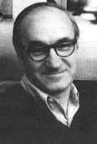
Albert bandura
BOBO Doll Experiment

Slide 50
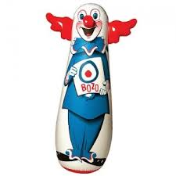
BOBO DOLL EXPERIMENT
In the famous Bobo Doll Experiment , Bandura demonstrated that young children would imitate the violent and aggressive actions of a model. In the study, young children saw a film of an adult hitting a 5 –feet-tall inflatable punching toy called Bobo doll . Later the children were given the opportunity to play with the bobo doll themselves .
Most children displayed same kind of behavior that they observed in the film and in some cases children mimicked the aggressive behavior almost identical.
Both positive and negative behaviors are acquired through the process of observation.

Slide 51
Thank you

